Slide 1
Technical areas that we work
Computational Social Science / Social Computing
Online Social Networks / Social Media Analysis
Graph theory / Statistics
Security & Privacy
Machine Learning / Deep Learning
Natural Language Processing

Slide 2
Research & Engineering Tracks
Paper
Conference / Journal
Tools
Browser Plugins
Building on Research
Part of research output

Slide 3
Projects (no particular order)
Legal AI
Code-Mixed
Hate Speech
Fake News
Fairness – Graphs
Fake content + Job portals + Knowledge Graph
Music + Social Media
Unlearning / Privacy
….

Slide 4
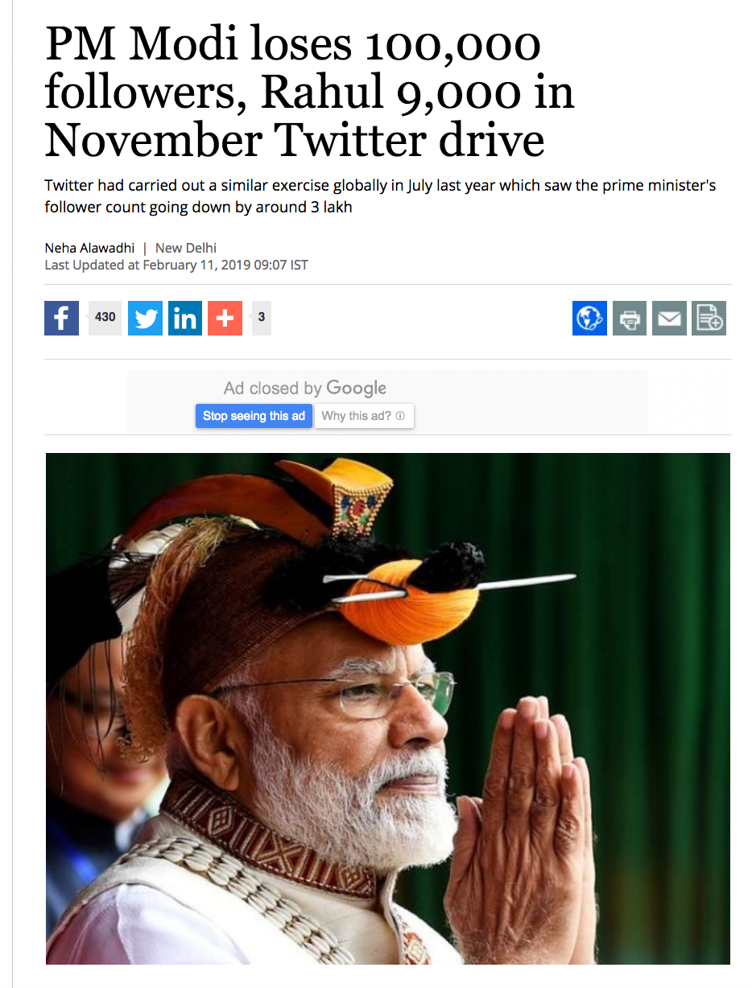
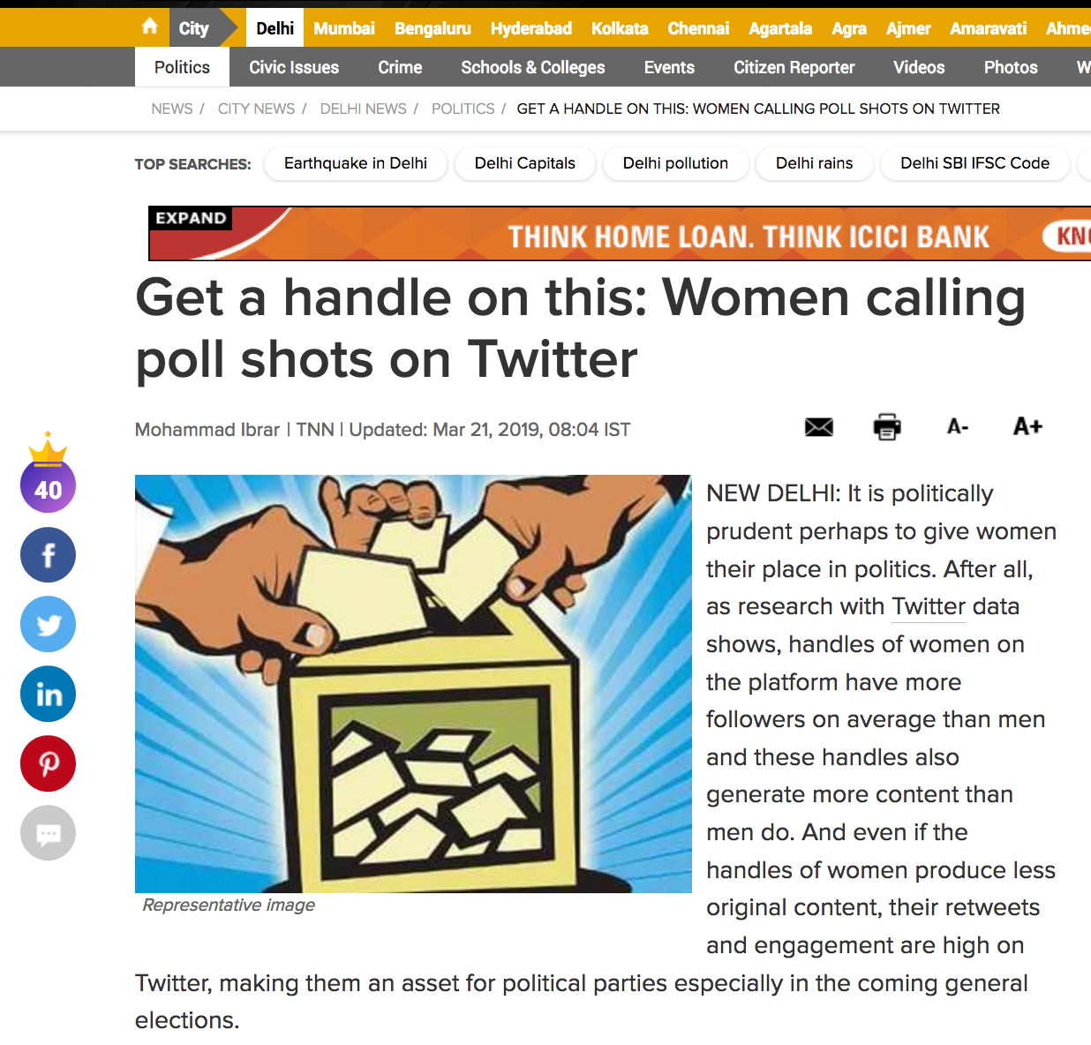

Slide 5

GaTech
UMich
Rutgers
Tartu Univ.
IIIT Delhi
IIT Madras (multiple)
IIT KGP
Adobe
Flipkart
Fidelity
IIIT Hyderabad
…..

Slide 6



Slide 7
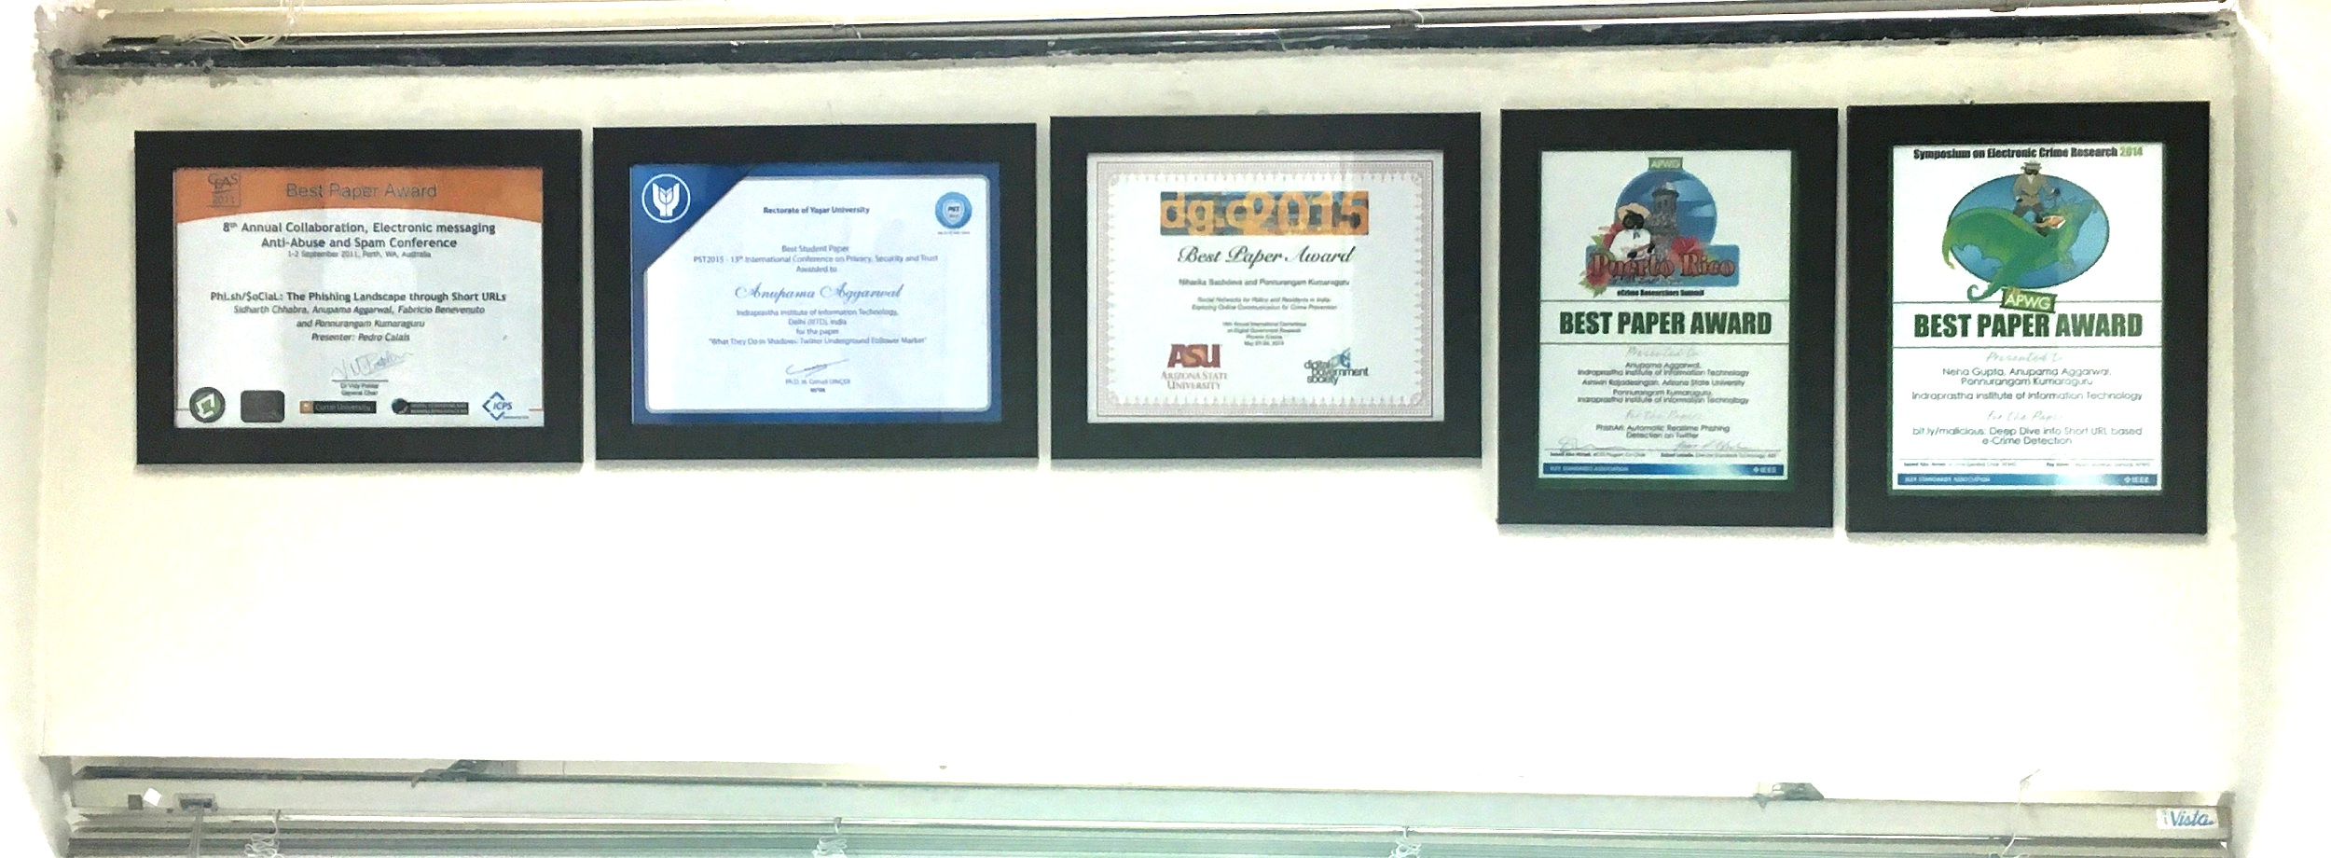


Slide 8
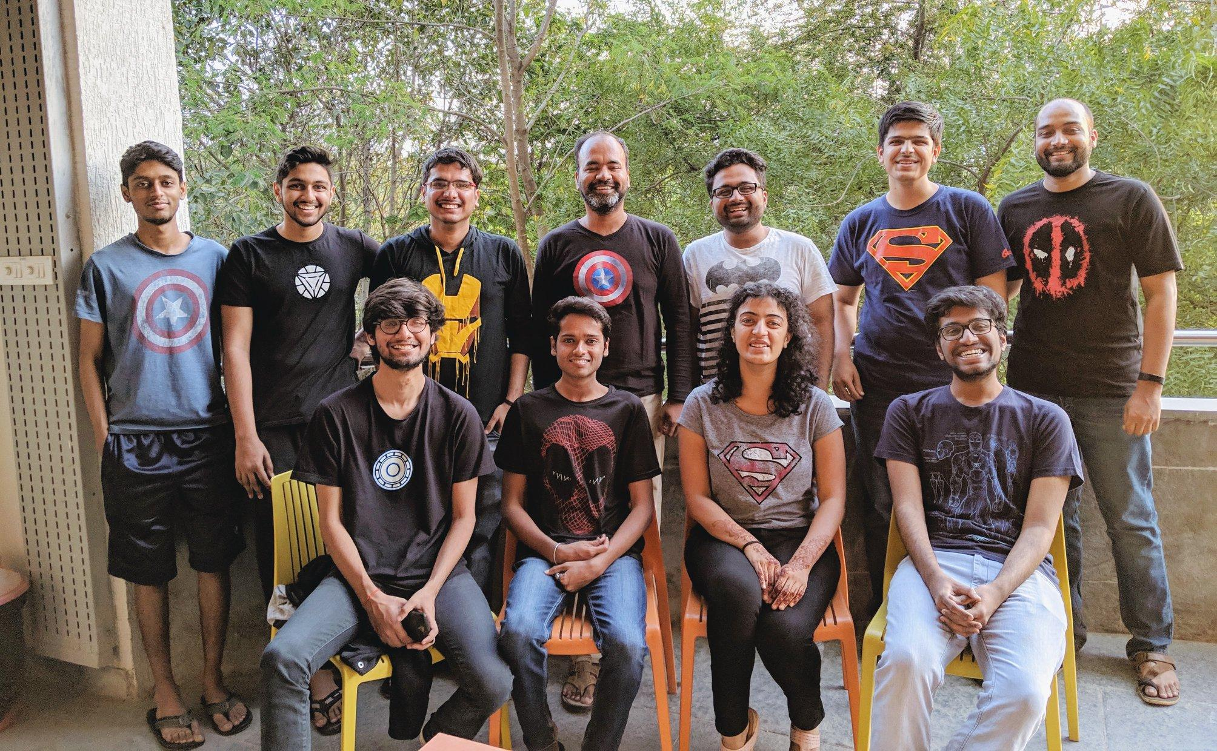
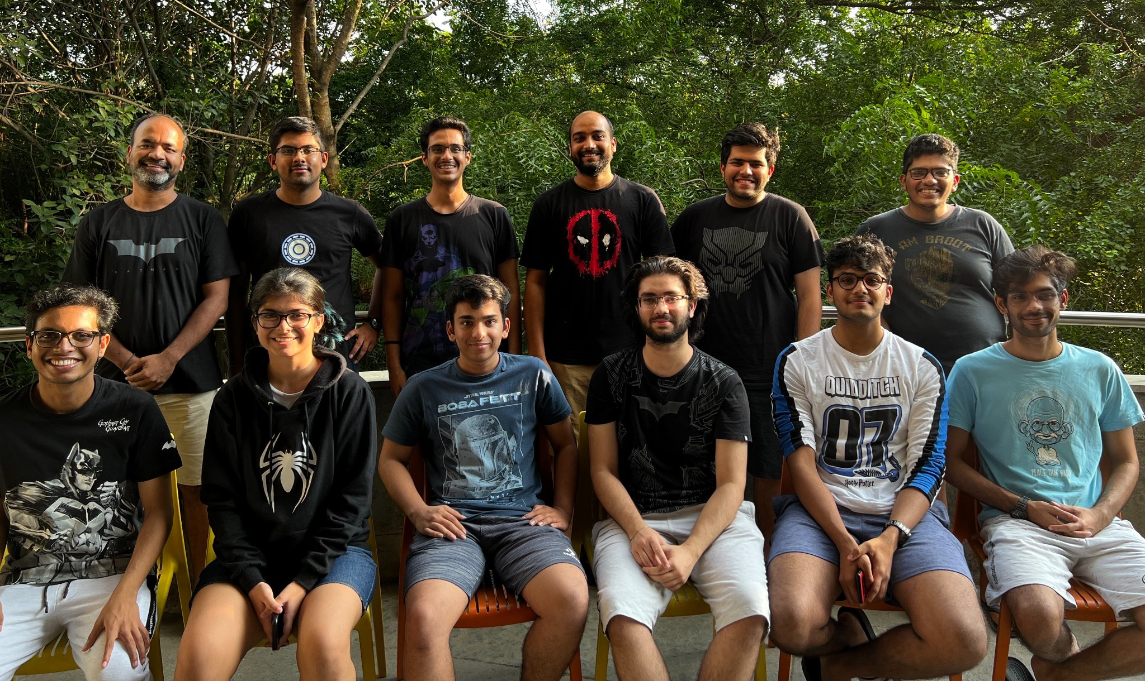





pk.guru@iiit.ac.in
https://www.instagram.com/pk.profgiri/
https://www.linkedin.com/in/ponguru/

